Slide 1
Water Information
Management Solution:
Product Demo for Drinking Water
Notes:
1

Slide 2
Table of Contents
Product overview
Product demo
Customer testimonials
Static slides (product screen shots)
Case studies

Slide 3

WIMS Product Overview
Table of Contents

Slide 4

Water Industry Data Management
The “Right” Solution
Hach WIMS™
Laboratory Data
Process Data
Other Data
LIMS
SCADA
Excel
Notes:
4

Slide 5
All the data you need is at your “fingertips,” in a secure, auditable database
Data sources:
Manual entry
SCADA interfaces
  Grab data from Intellution, Wonderware, Rockwell, SCADA systems, etc
  Grab data from Hach sc network
  Summarize
  Store in WIMS
LAB interfaces
  Import data from your commercial labs
  Import data from your Hach lab instruments (DR, HQ, etc)
  Import from your LIMS
Automatic calculations

Slide 6
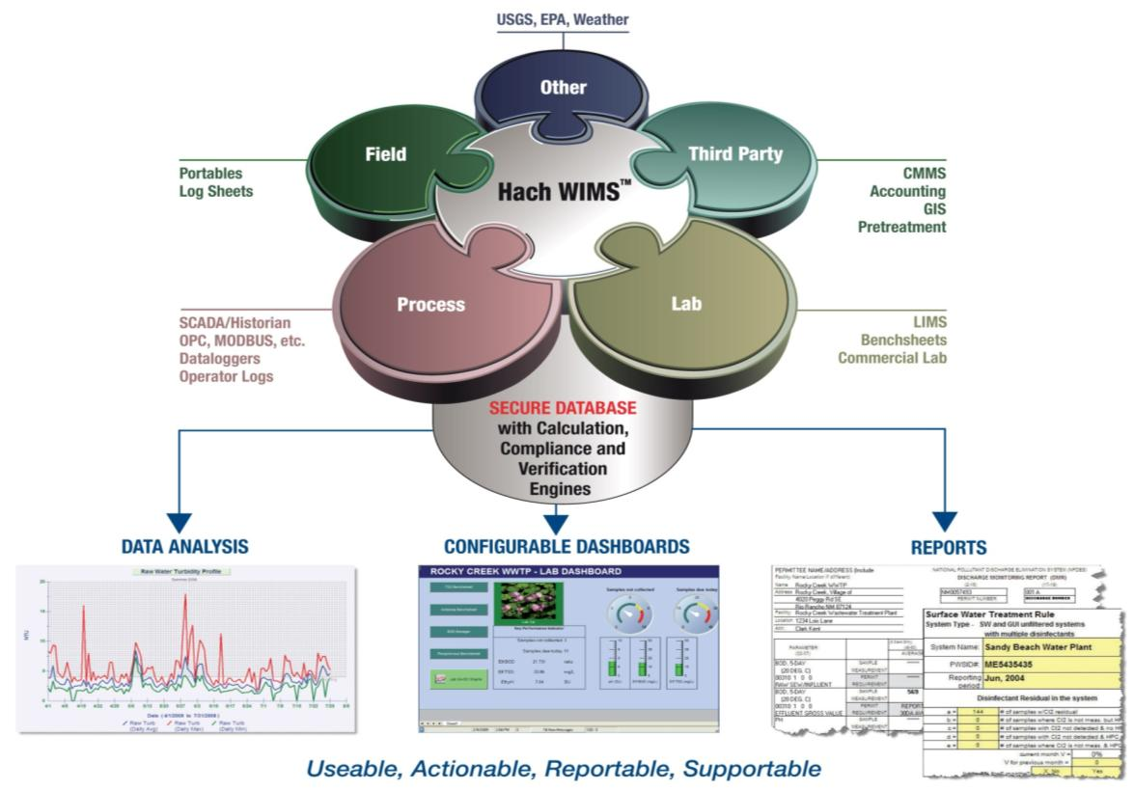
Accurate Information – Informed Decisions
Data comes together in a central database
  Easy access, local or over secure Web
  Data ALWAYS available
Safe and secure historical records
Accurate data entered one time
Audit trails
Notes:
Hach WIMS is a central repository for data. It collects data from many sources either electronically or manually and puts it into a secure database. Data can be collected from SCADA systems, LIMS systems, laboratories, the field, other entities and agencies. The compliance and verification engine does an incoming data check to make sure that values are within defined limits. Those limits can be EPA limits or can be user defined control limits. Alerts are generated to allow a quick response to any problems. The calculation engine has a large number of built-in formulas to make it easy to generate reports and data for analysis. The system knows how to consistently handle data qualifiers according to EPA requirements. Data is accurate and secure. The database can only be accessed by authorized users and login screens are configurable to each user. The system easily provides reports, graphs, dashboards, etc for easy EPA compliance and data analysis

Slide 7
WIMS Demonstration Tool
Table of Contents

Slide 8
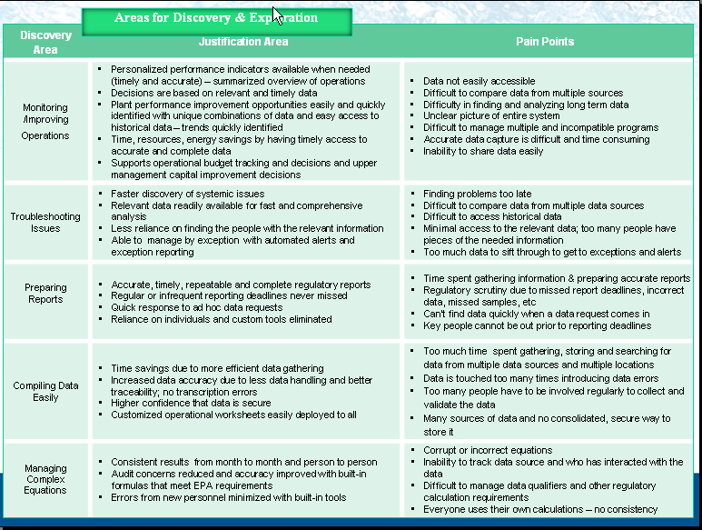
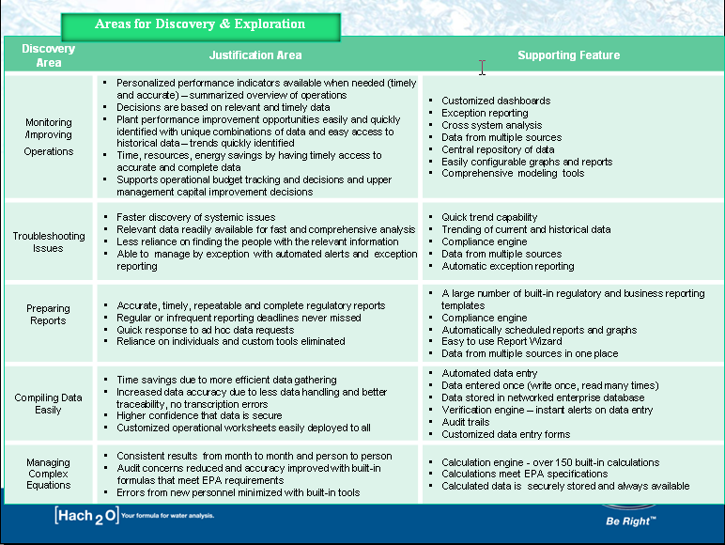
Areas of Discovery and Exploration
(Click on hyperlink to navigate to the “Area of Discovery”)
Monitor & Improve Operations
Troubleshoot Issues
Prepare Regulatory & Internal Reports
Easily Compile Data
Manage Complex Calculations

Slide 9

Monitor and Improve Operations
Dashboards
Manage data by exceptions
Alert Notifications
Multiple graphs
Notes:
9

Slide 10
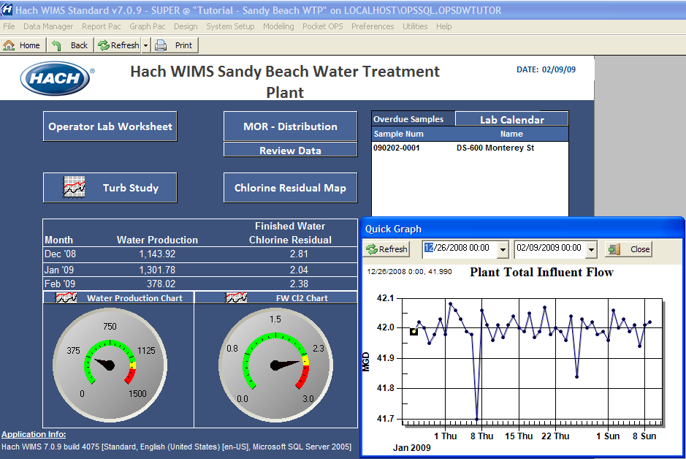

Dashboards-Key Performance Indicators at a glance

Slide 11
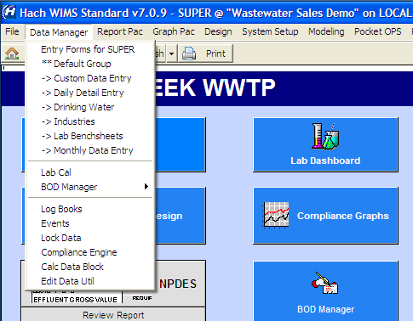
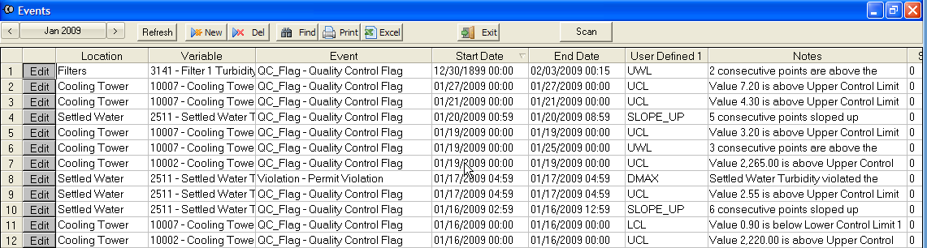
Manage Data by Exception
The Compliance Engine scans your database for regulatory violations and QC Flags.
Click Data Manager
Select Events

Slide 12
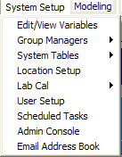
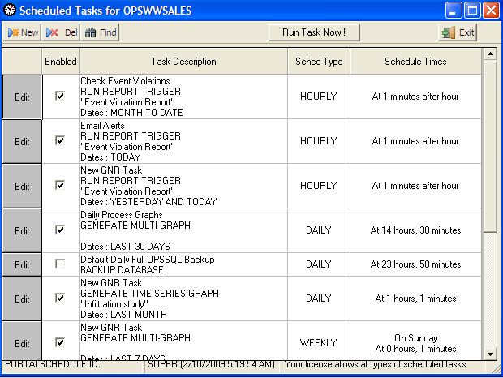
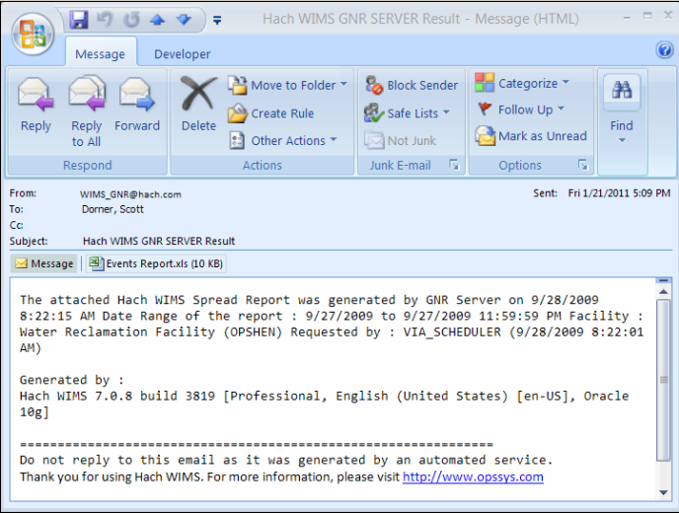
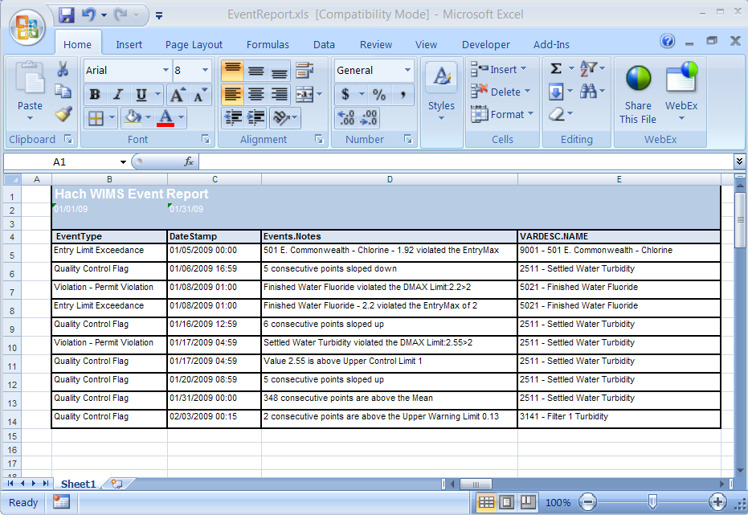
Alert Notifications
List of all Scheduled Tasks includes Event Violation Report
Sample of an Alert Email
Sample Report
Click System Setup
Select Scheduled Tasks
Add or Edit Tasks
View Emailed Alert
View Attached Report

Slide 13
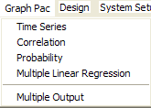
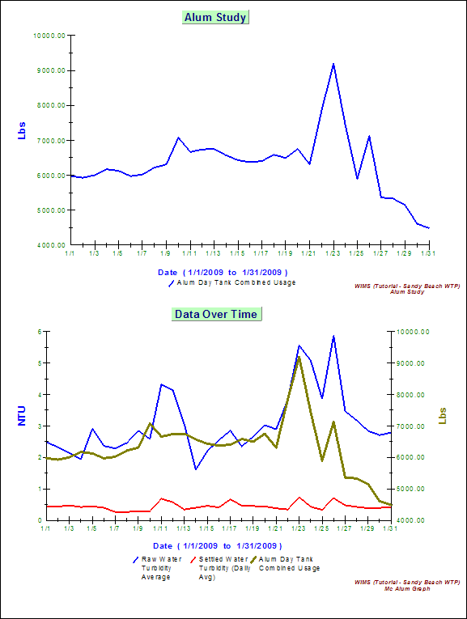
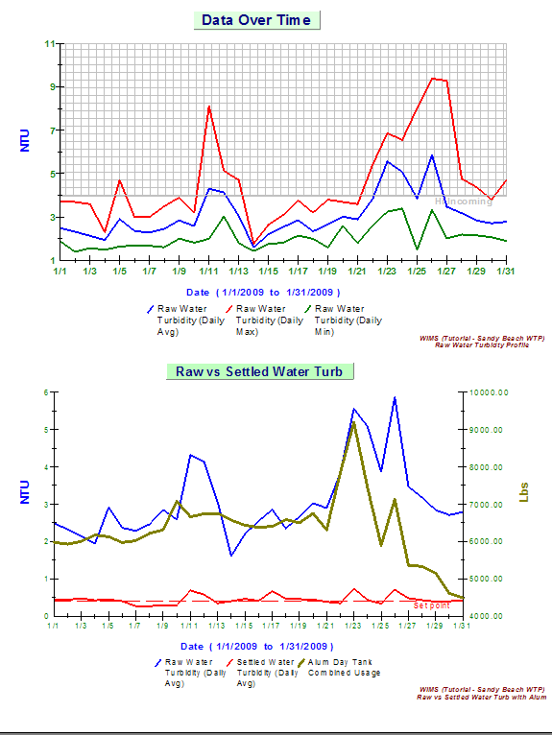
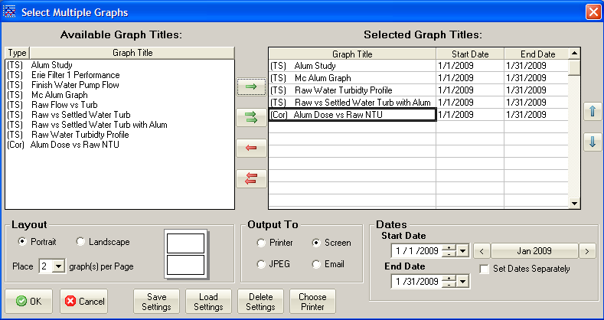
Multiple Graphs
Notice that the graphs contain permit or user defined limits.
For Example, the graph shows 1 violation for Effluent TSS
This screens sets the Options for Multiple Graph Output
This report contains 5 graphs
Click Graph Pac and Multiple Graphs
Select your Options
Click OK to view the Graphs
The graphs allow for visualization of data
Click Next to view other graphs

Slide 14
Areas of Discovery and Exploration
(Click on hyperlink to navigate to the “Area of Discovery”)
Monitor & Improve Operations
Troubleshoot Issues
Prepare Regulatory & Internal Reports
Easily Compile Data
Manage Complex Calculations

Slide 15
Troubleshoot Issues
Flag problems in the data / Audit Trails
Verify equations
Highlight exceptions with graphs
Notes:
15

Slide 16
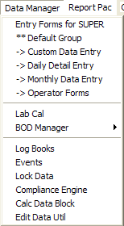
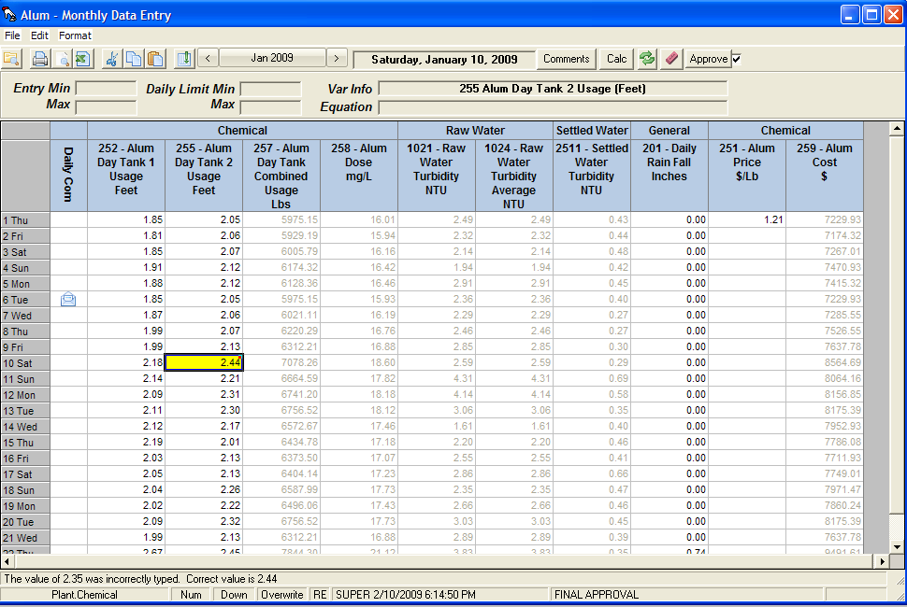
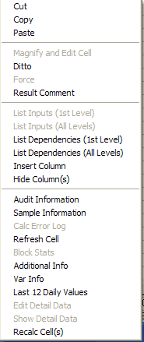
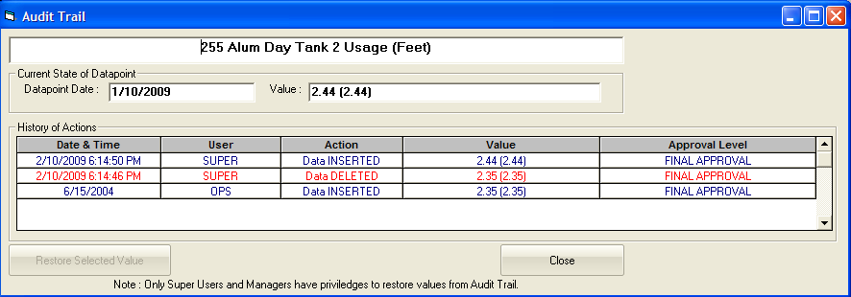
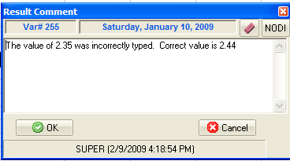
Flag Problems in the Data
Values above limits are bolded. Comments (red dot) can be imbedded in the cell
Click Review Report & Monthly Data Entry
Notice the Red Dots
Right-click on a result to open the menu
Select Result Comment to view or add a comment
Select Audit Information
The Audit Trail is a “fingerprint” for the data. You know who entered the data, deleted or changed the data. This gives you the piece of mind knowing that the data is safe.
The comments help explain that the violation was due to a broken drive belt.

Slide 17
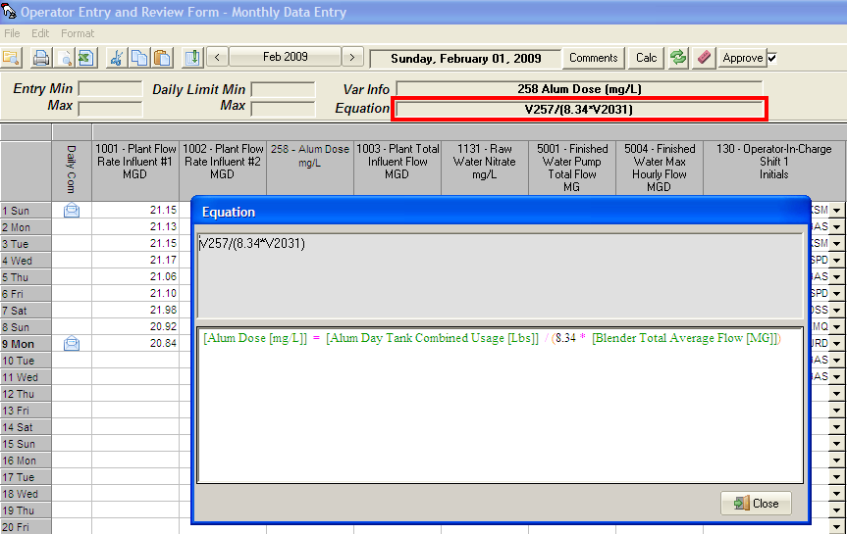
Verify Equations
Equation is in plain English, therefore easy to understand, verify, and, unlike Excel, does not break down if changes are made to the cell
On Review Form
Double-Click Equation Box
View the explained equation

Slide 18
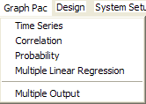
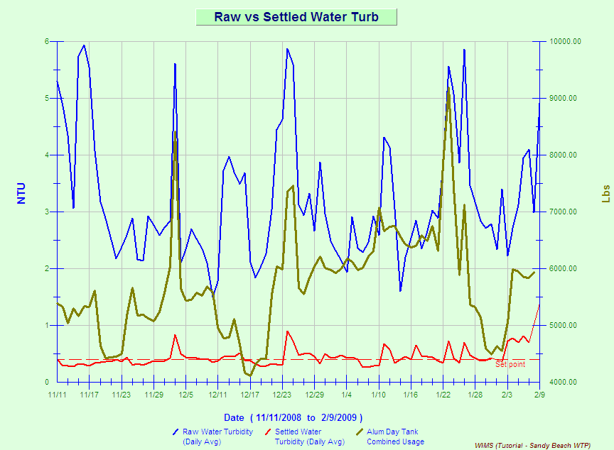
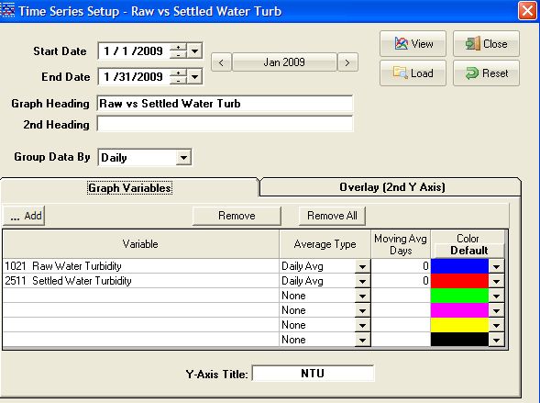
Highlight Exceptions with Graphs
Note how raw water turbidity is correlated with alum dosing.
Note how easy (and quick) it was to conduct this Turbidity study. Contrast this with any other commercially available software!
Click Graph Pac
Select Time Series
Click Add to add variables
Click View to view graph
Change to 90 Day View

Slide 19
Areas of Discovery and Exploration
(Click on hyperlink to navigate to the “Area of Discovery”)
Monitor & Improve Operations
Troubleshoot Issues
Prepare Regulatory & Internal Reports
Easily Compile Data
Manage Complex Calculations

Slide 20
Prepare Regulatory & Internal Reports
Drinking water compliance reports
Numerous report templates
Create reports with wizard
Schedule automatically delivered reports
Notes:
20

Slide 21
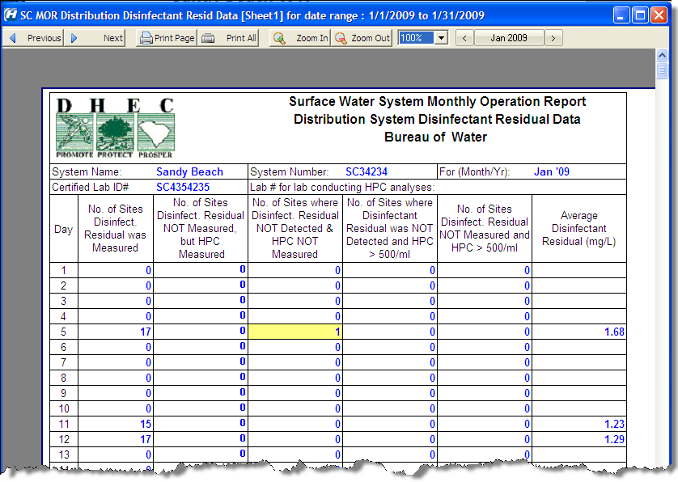
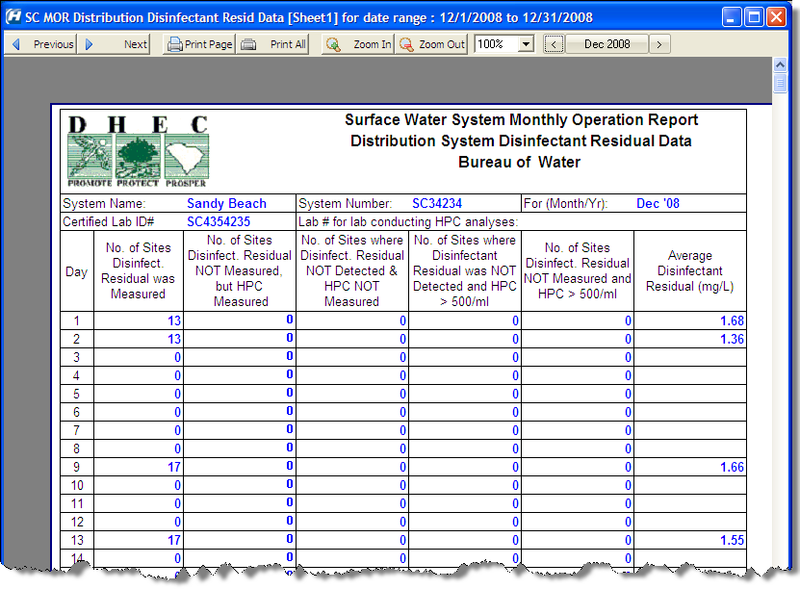

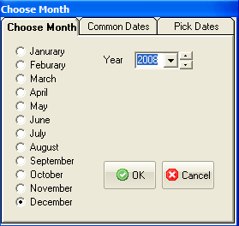
Drinking Water Compliance Reports
With a click of a button, the program gathers all the information for your regulatory report and prints it automatically
…and, here is the MOR for the previous month, December 2008, accessed with just a few clicks!.
Click on MOR
View the Last Full Month’s Report
Click the Month Selector to change months
Select December 2008 and click OK

Slide 22
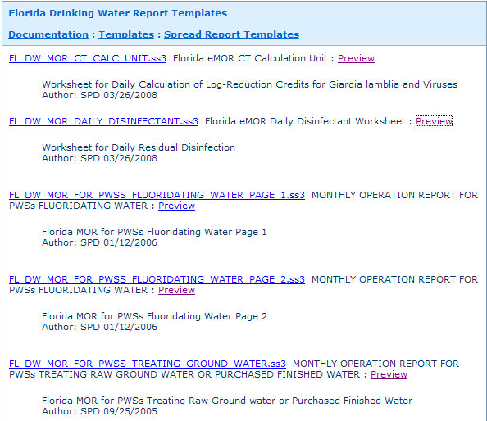
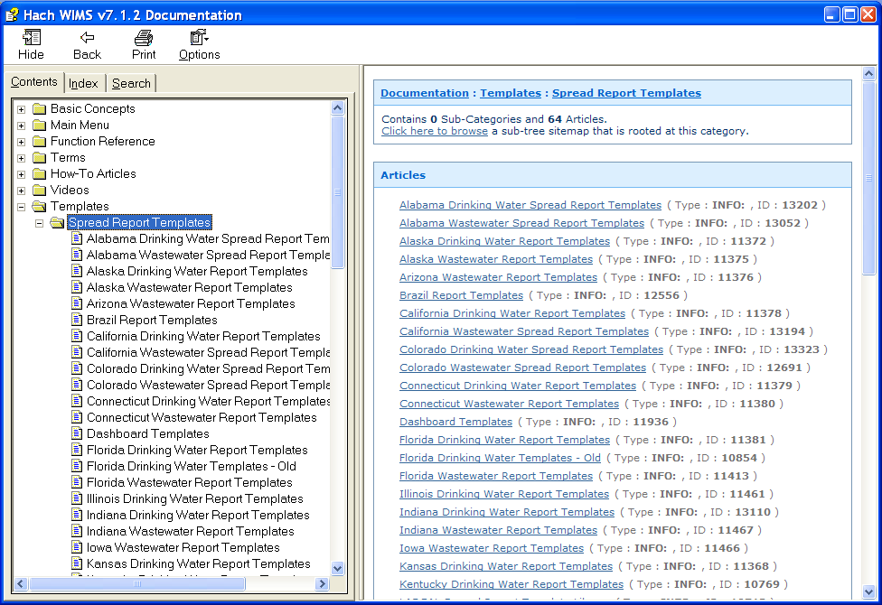
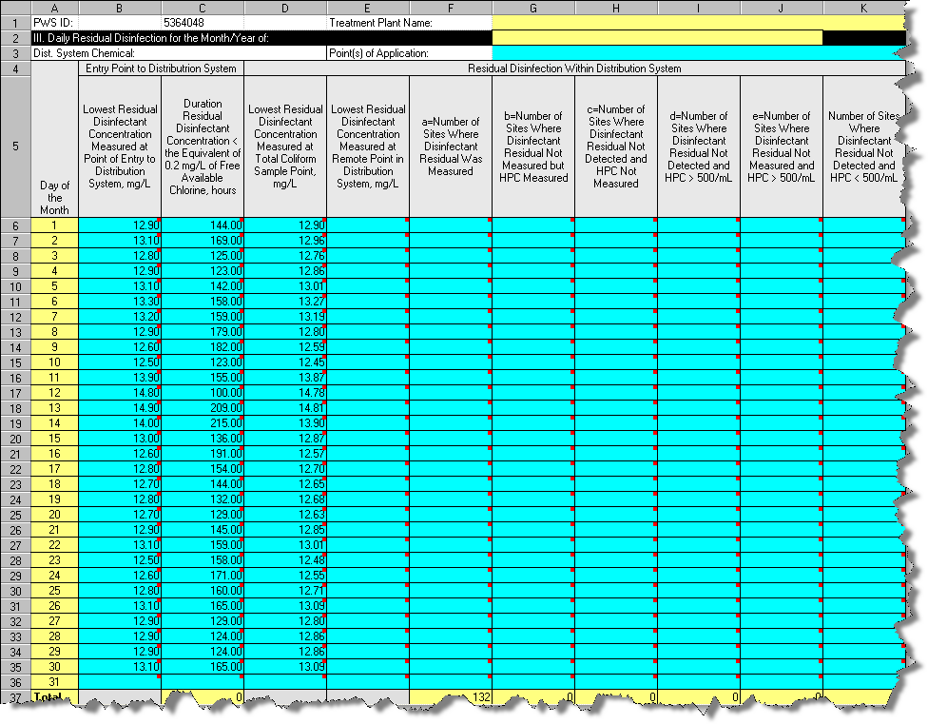
Numerous Report Templates
Click on Help
Select Templates – Spread Report Templates
Click Florida Drinking Water from the list
Click Preview to view the template

Slide 23
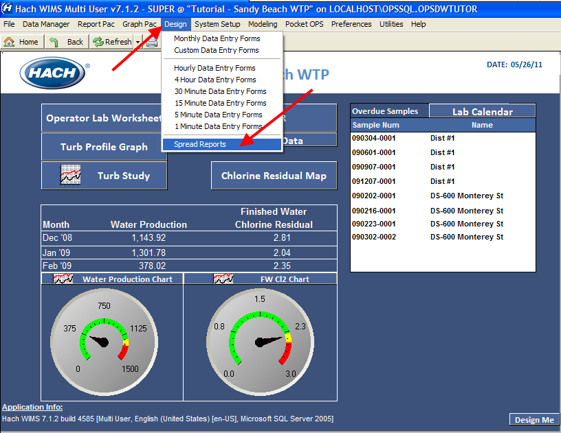
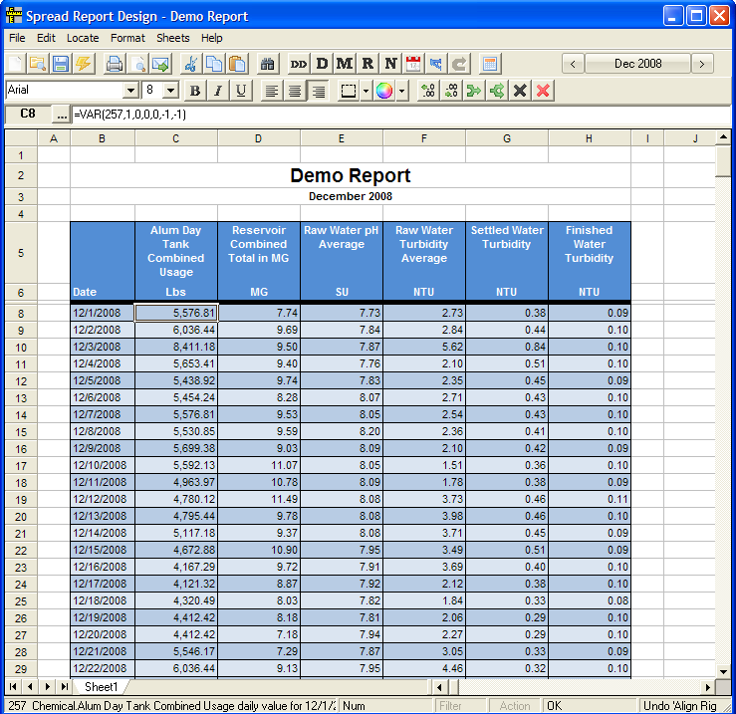
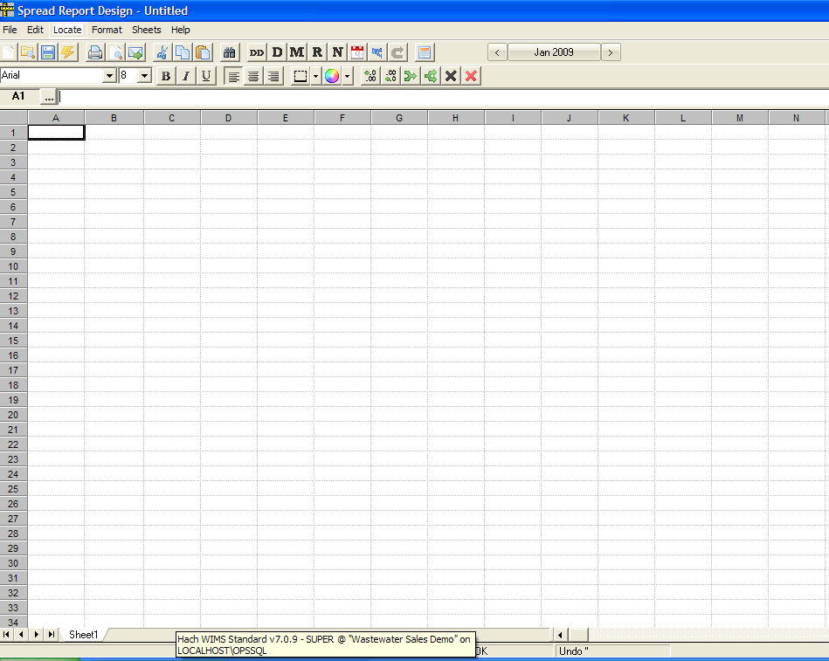
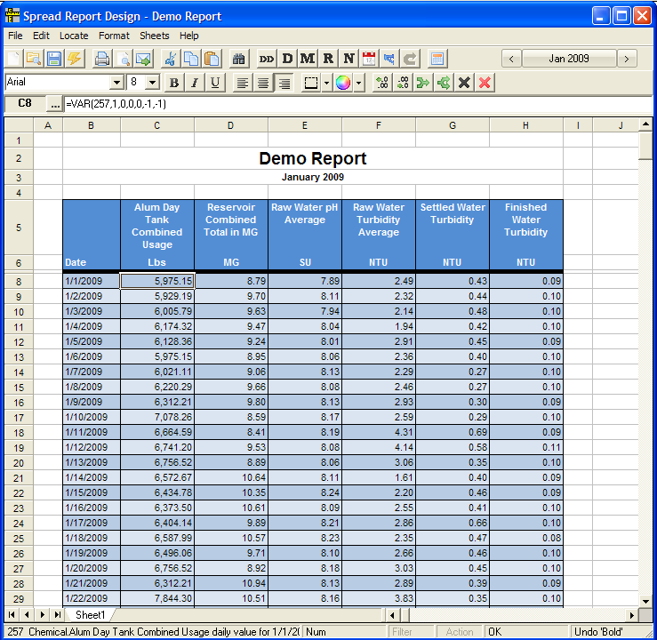
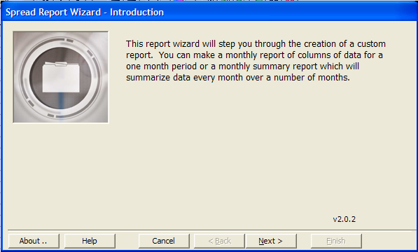
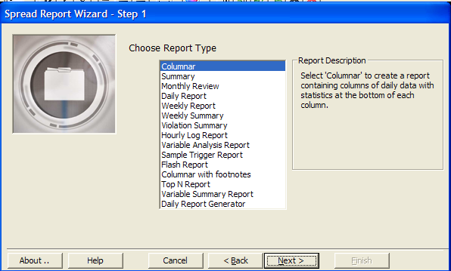
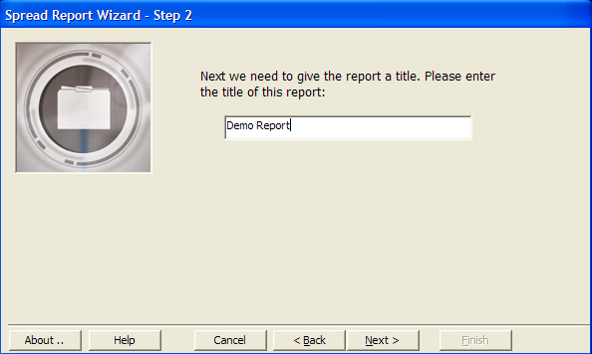
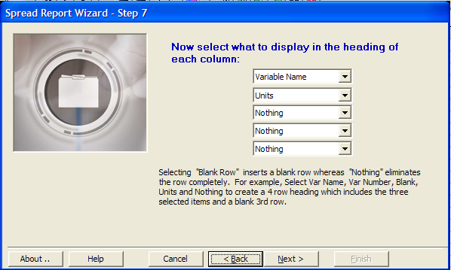
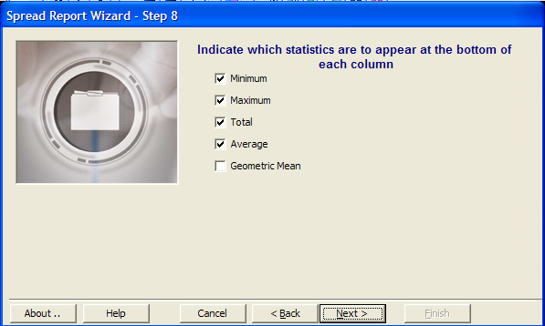
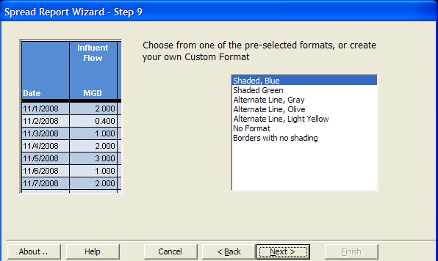
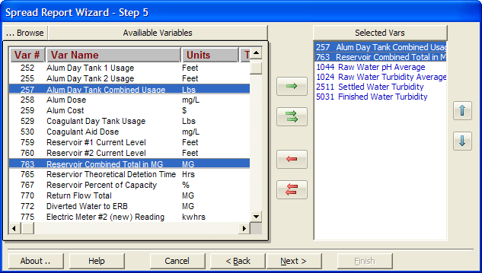
Create Reports with Wizard
Click the date selector to move back a month
When you are satisfied, Save this report as a template, so that is available, in future, on-demand. You can view the report under the “Report Pac” menu
The Spread Report Designer looks like a Spreadsheet, but it is much more than just a single spreadsheet.
Based on the selections made, WIMS builds your report.
Click on Design
Select Spread Reports to begin a new report
The Spread Designer opens, note it looks like a spreadsheet
Click Lightning Bolt to start the wizard
Move through the Wizard by clicking Next
When finished your report will appear
The data is not static, you can change dates
Click Save to save the report

Slide 24
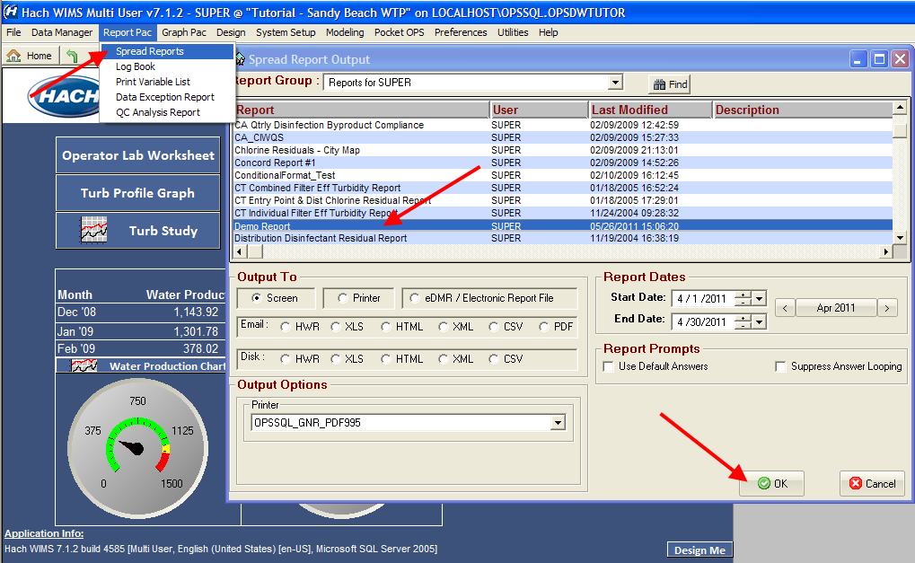
Create Reports with Wizard
Here it is!
There are many Options that can be used to output any report
Click on Report Pac
Select Spread Reports
Select demo report to open the report you just created
Note all the options when generating a report
Click OK to view the report on the screen

Slide 25
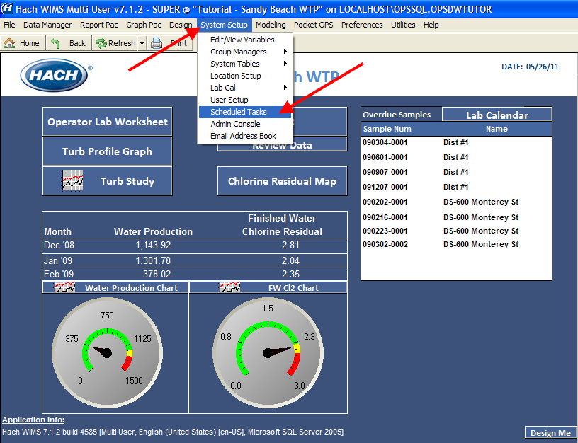
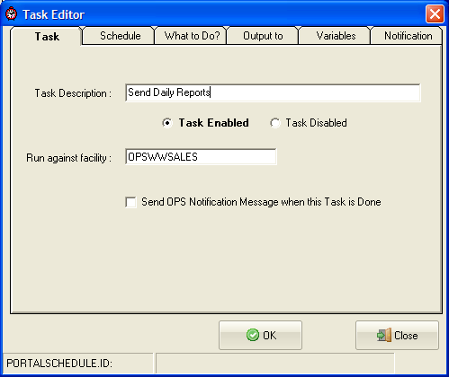
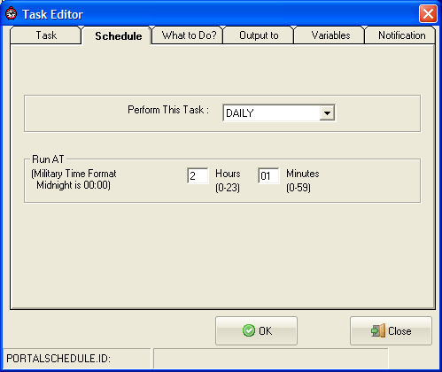
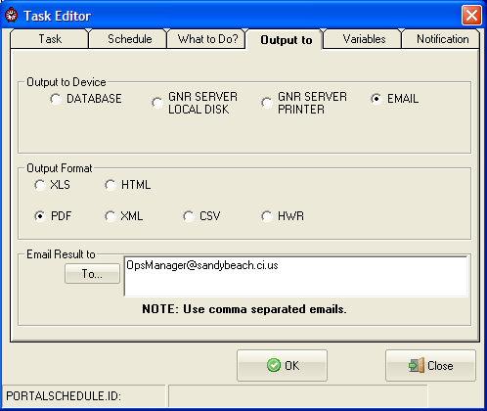
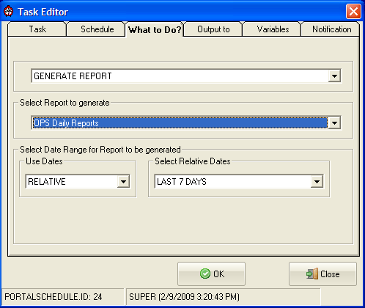
Schedule Automatically Delivered Reports
Note all the different Output Devices and Formats
Click System Setup
Select Scheduled Tasks
Click New to create a new alert
Move through the Tabs to define what you want to schedule
Click OK to finish scheduling this new task

Slide 26
Areas of Discovery and Exploration
(Click on hyperlink to navigate to the “Area of Discovery”)
Monitor & Improve Operations
Troubleshoot Issues
Prepare Regulatory & Internal Reports
Easily Compile Data
Manage Complex Calculations

Slide 27
Easily Compile Data
Manual data entry
Automatic data entry through interfaces
Notes:
27

Slide 28
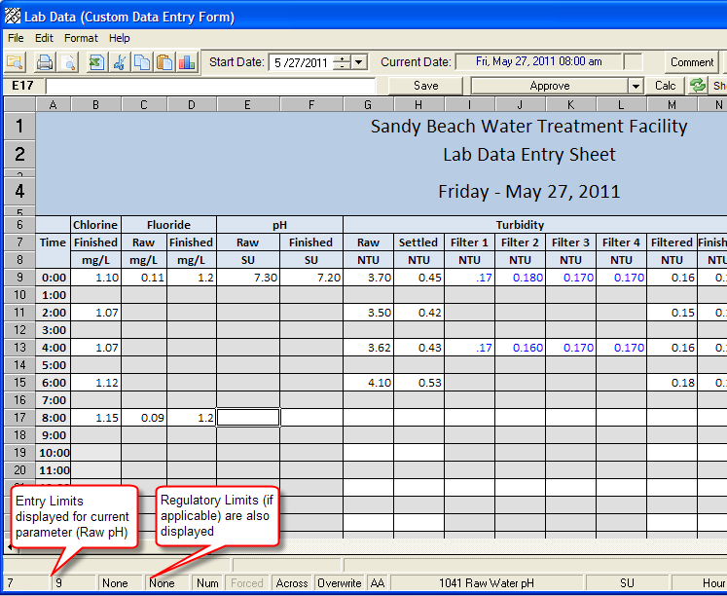
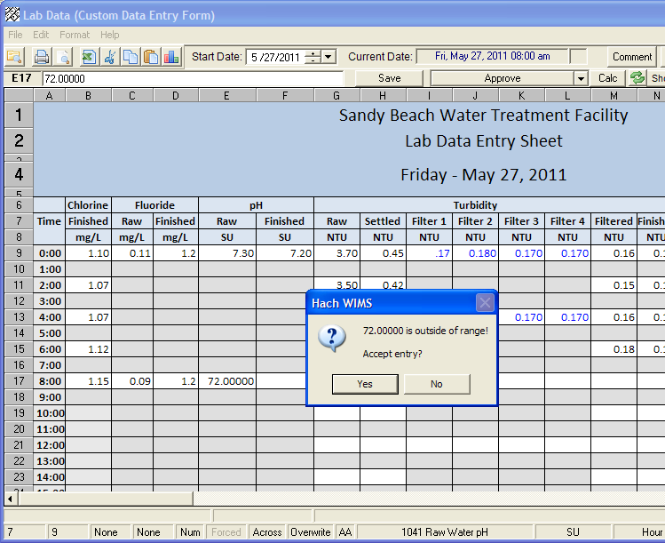
Manual Data Entry
Hach WIMS will alert me if I enter a value outside these limits in this cell
Oops, I forgot to include the decimal point.
Click on Operator Lab Worksheet
Click on a cell and enter data
Data is automatically checked

Slide 29
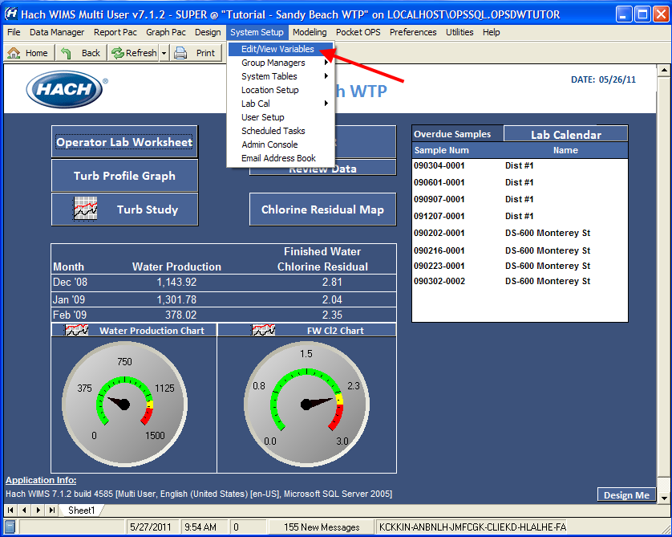
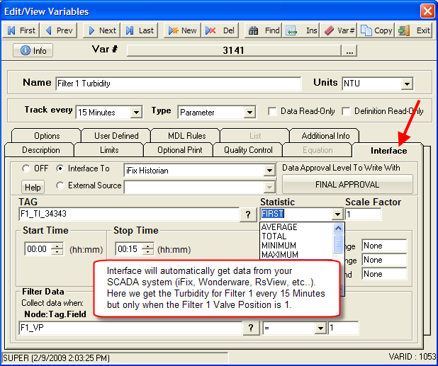
Automatic Data Entry through Interfaces
Click on System Setup
Select Edit/View Variable
Click Interface tab (note: this is only available to certain admin users)
Note all the Options available to configure an Interface

Slide 30
Areas of Discovery and Exploration
(Click on hyperlink to navigate to the “Area of Discovery”)
Monitor & Improve Operations
Troubleshoot Issues
Prepare Regulatory & Internal Reports
Easily Compile Data
Manage Complex Calculations

Slide 31
Manage Complex Calculations
Huge library of functions
Support for complex calculations
Notes:
31

Slide 32




Huge Library of Functions
100+ water and wastewater specific equations
Click “Function Reference”
Weekly average is simply an average of 7 numbers, but what is the definition of a week?
Click to find out
Scroll down and Select WAVGn
Click on Help
Select Chapters > Function Reference
Click Math Toolbox Functions
Scroll to find the WAVGn function
Powerful functions with lots of options
Click defines the week to see the week options

Slide 33


Huge Library of Functions
Is it Sunday to Saturday, Monday to Sunday,…1st to the 7th, 7th to the 14th,…How is a week different for February vs. March?...Leap year vs. not?.....
There are 21 definitions of the week, as defined by State and Federal regulations. This is a good example of how Hach WIMS takes a seemingly simple (but very complicated) tasks and greatly simplifies the calculation.

Slide 34




Support for Complex Calculations
Examine a complex calculation, Contact Time Required for compliance
In a Data Entry Form select a calculated result
Double-click the Equation box
WIMS supports very complex calculations
Right Click, List Inputs to troubleshoot the formula

Slide 35
End of Demonstration Tool

Slide 36
Customer Testimonials
Table of Contents

Slide 37

Monitor & Improve Operations
“Hach WIMS has fostered analysis beyond regulatory data. Information on pumping stations, energy usage, material usage, and cost analysis are just a few of the trends performed to enhance ‘optimization.’ The new question is not ‘Can we analyze the data?’ but ‘Which data do you want to analyze?’”
Gwinnett County, GA

Slide 38

Monitor & Improve Operations
“We love this software. I have the time to give this reference because I have the software!”
James Grandstaff
Division Director
Henrico County Water Reclamation Facility, VA

Slide 39
Monitor & Improve Operations
“The Hach WIMS product has been instrumental in the collection of relevant data. Its data capture and reporting capabilities have provided us a comprehensive analysis of our wetlands pilot project.”
Stephanie Eisner
Natural Reclamation System Proj. Coordinator
City of Salem, WA
Notes:
39

Slide 40
Monitor & Improve Operations
“Hach WIMS has fostered analysis beyond regulatory data. Information on pumping stations, energy usage, material usage, and cost analysis are just a few of the trends performed to enhance ‘optimization.’ The new question is not ‘Can we analyze the data?’ but ‘Which data do you want to analyze?’”
Gwinnett County, GA

Slide 41
Prepare Regulatory & Internal Reports
“The biggest advantage in our implementation of Hach WIMS is the automation of our reports. Reports that typically would take weeks at a time to prepare, now only take us a matter of a few hours. Additionally Hach WIMS fills a much needed gap. Our Operations Department now has access to data that allows them to make adjustments within their operational parameters in hours – instead of days.”
Peter Chang, System Engineer III King County, WA

Slide 42
Easily Compile Data
“Hach WIMS is central to everything that the LEWWTP does. Each system that the LEWWTP has provides data into Hach WIMS. It is essential to our process decisions.”
Brenna Durkin
DBA Specialist
Littleton/Englewood Wastewater Treatment Plant
Notes:
42

Slide 43

Q&A
Notes:
43

Slide 44
Static slides
(Use for non-demo presentations)
Table of Contents

Slide 45
Monitor & Improve Operations

Slide 46




User Defined Dashboards
Hach created examples
Customer generated
Notes:
46

Slide 47

Manage by exception…
The Compliance Engine scans your database for regulatory violations and QC Flags.
Notes:
47

Slide 48


Manage by exception…
Track events (violations or user defined) and setup email alerts…
Notes:
48

Slide 49


Compliance charts
Automatically chart data for key plant parameters.
Notes:
49

Slide 50


Central location for all of your data
View of the database that showcases how parameters (variables) are organized
Wastewater
Drinking water

Slide 51
Troubleshoot Issues

Slide 52
Let Software do the Detective Work
Gather information and find answers to:
  System upsets
  Cost overruns
  Compliance issues
  Customer complaints
Use predictive modeling tools to prevent future issues from occurring
  Develop "what if" scenarios
Perform simple or complex search queries
  Find the exact information you need
Notes:
52

Slide 53

Automatically Compare & Verify All Info
Flags problems so you know exactly where they occurred
Immediately identifies change in the system
Notes:
53

Slide 54

Maintain Accurate Records with Audit Trails
Audit trails show who touched the data
Notes:
54

Slide 55

Waste water example-Inf flow v. rainfall
As one might suspect, influent flow increases when rainfall increases

Slide 56

Drinking water example—turbidity profile
Raw water turbidity from 3 sources
Utility goal: Try not using the “red” source!

Slide 57
Prepare Regulatory & Internal Reports
Create reports in seconds and then schedule them to print or email automatically
Notes:
57

Slide 58



Turn Raw Data into Actionable Information
Create business and regulatory reports instantly
Schedule automatic report output to the screen, print or email
Quickly configure standard reports using templates and wizards
Utilize built-in EPA and state report templates (SWTR, DBR, NPDES, DMR, eDMR, MOR, SDWA, CCR, industrial pretreatment compliance, and more)
Notes:
58

Slide 59


Accurate Regulatory & Process
Reports & Graphs
Drinking Water
Create paper and electronic reports for Waste Water and Drinking Water for each state
Notes:
WIMS program automatically generates relevant MORs/DMRs/NPDES forms for regulatory reporting (far back). We have forms for every State in the Nation. Using a wizard (similar to the graphing wizard in Excel), custom reports (front) can be generated within a few clicks…

Slide 60


Powerful Information at your Fingertips
Waste Water
Example Discharge Monitoring Report
Example Inflow/ Infiltration Study
Notes:
Hach WIMS manages data and provides reports and analysis for waste water facilities. Data can be gathered from many sources and compared for comprehensive analysis. With a mouse click, regulatory and business reports can be easily generated, historical data can be accessed and used for statistical analysis and systems can be monitored for optimal performance. Data can be analyzed for optimization projects and can be made readily available to anyone who has a need for the data. Time series, correlation, trending and more are all available. Many states are also moving to electronic reporting requiring a more sophisticated solution than manual or excel based systems.
60

Slide 61



Compliance reports for every State in the Nation
Hach Company will keep up-to-date compliance report formats (including eDMR/eMORs..)
Notes:
61

Slide 62
Compile Data Easily
More data is not better unless you can do something with it
Notes:
62

Slide 63



See Your Whole Operation: Combine Data From Field, Lab & Operations
Instant access to data, reports, entry forms, audit information
Easy-to-interpret format
Track dosages, flows, concentration, summarized data like daily average flow, 15 minute turbidity maxi, hourly DO min
Notes:
Data Overload? Make it Meaningful.
Data is dumb. We make it smart.
Data combined from multiple sources shows complete picture of your water/waste water systems
Receives data automatically from the most commonly used data systems plus manual entry directly into database.
63

Slide 64


Transform Data Dumps
Into Actionable Insight
Manual Data Entry:
Built-in templates for data entry
Screens that match spreadsheet, daily log and bench sheet formats
Automated Data Entry:
SCADA
Dataloggers
LIMS
Commercial Laboratory Reports
Download data from portable field devices
Notes:
Data Overload? Make it Meaningful.
Data is dumb. We make it smart.
Data combined from multiple sources shows complete picture of your water/waste water systems
Receives data automatically from the most commonly used data systems plus manual entry directly into database.
64

Slide 65
Managing Complex Calculations
With 100+ built-in formulas, you can stop worrying about making mistakes in complex calculations

Slide 66

You Don’t Need to Be a Statistician
Built-in equations and verification engines
Easily add additional formulas
Calculate and track just about anything
Error and worry free
Get consistent results based on EPA requirements
100+ water/ waste water industry-specific formulas
Error and worry free built-in calculations provide data consistency

Slide 67

Example of Built-in Complex F-to-M Ratio
This cell result based on this formula

Slide 68
Case Studies
Table of Contents

Slide 69

Case 1: Improving Aeration Efficiency
Oxygen transfer efficiency is a function of bubble size. The smaller the bubble, the higher the efficiency. Ceramic or membrane diffusers will foul in time, causing the bubble size to increase. To minimize energy used and reduce downtime, it is important to determine when diffusers need to be cleaned.
Clients use WIMS™ to determine cleaning cycle by benchmarking pounds of BOD removed per KW of electricity used.
Notes:
69

Slide 70

Case 2: Lowering Chemical Costs
In the chart of raw and settled water turbidity against alum dosage (obtained by using graphing tools in WIMS™), the client recognized that increased alum dosing (circled) did not improve settled water turbidity. This led to an opportunity to save up to 10 percent in alum dosage.
Notes:
70

Slide 71

Case 3: Real-time estimation of BOD
The time-lag in obtaining BOD results, a 5-day lab test, make it challenging for plant operations to adjust treatment processes to adverse levels of BOD. By using powerful statistical tools built into WIMS™, a site-specific correlation between on-line UV absorbance against lab BOD measurements was obtained. The client can now estimate BOD in real-time, allowing for the optimization for treatment processes and avoid potential violations.
Notes:
71

